Slide 1


AXOVET: Veterinary therapeutic applications
Advanced cell-based and cell-free therapies for equine, companion and camel medicine.
Axovet is the veterinary branch of Revatis SA, a spin-off from the University of Liège (Belgium).
Mission: Develop and commercialize innovative cell products and biologics for veterinary regenerative medicine.
Foundation: Built on two patented platforms — muscle-derived stem cells (mdMSCs) and secretome / EVs.
GDP authorization as wholesaler for distribution of veterinary biologics and pharmaceutical products.

Slide 2

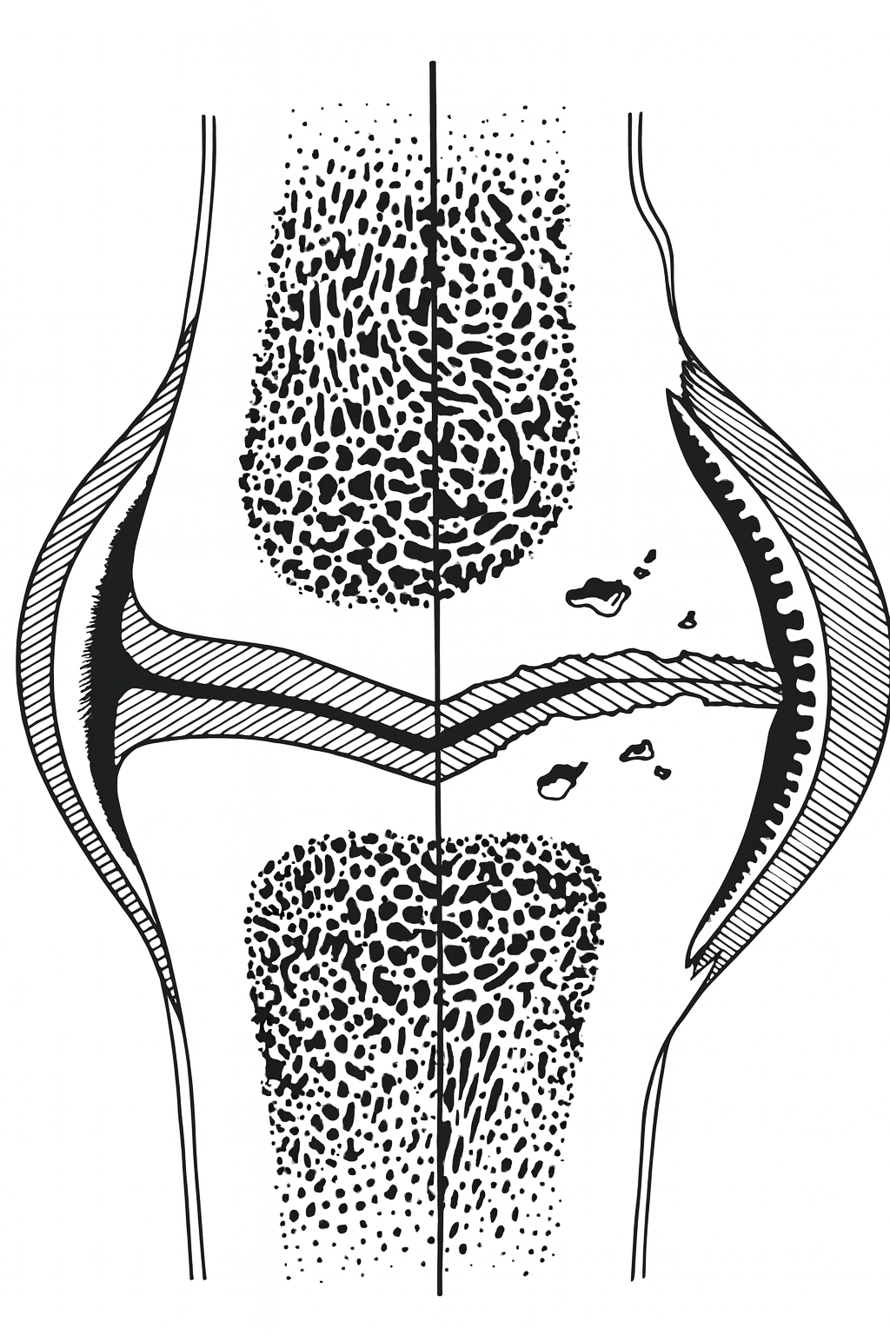

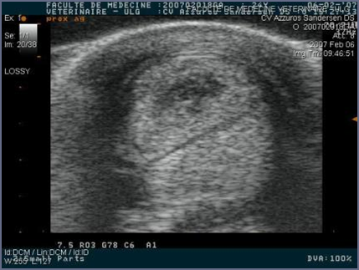

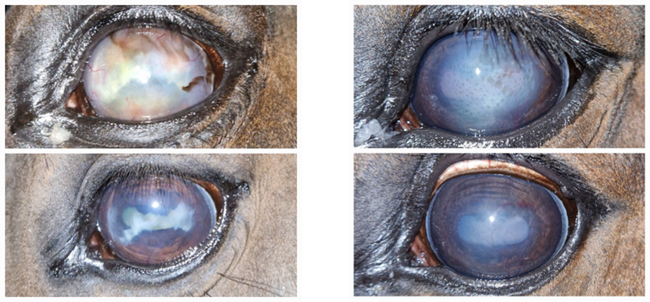
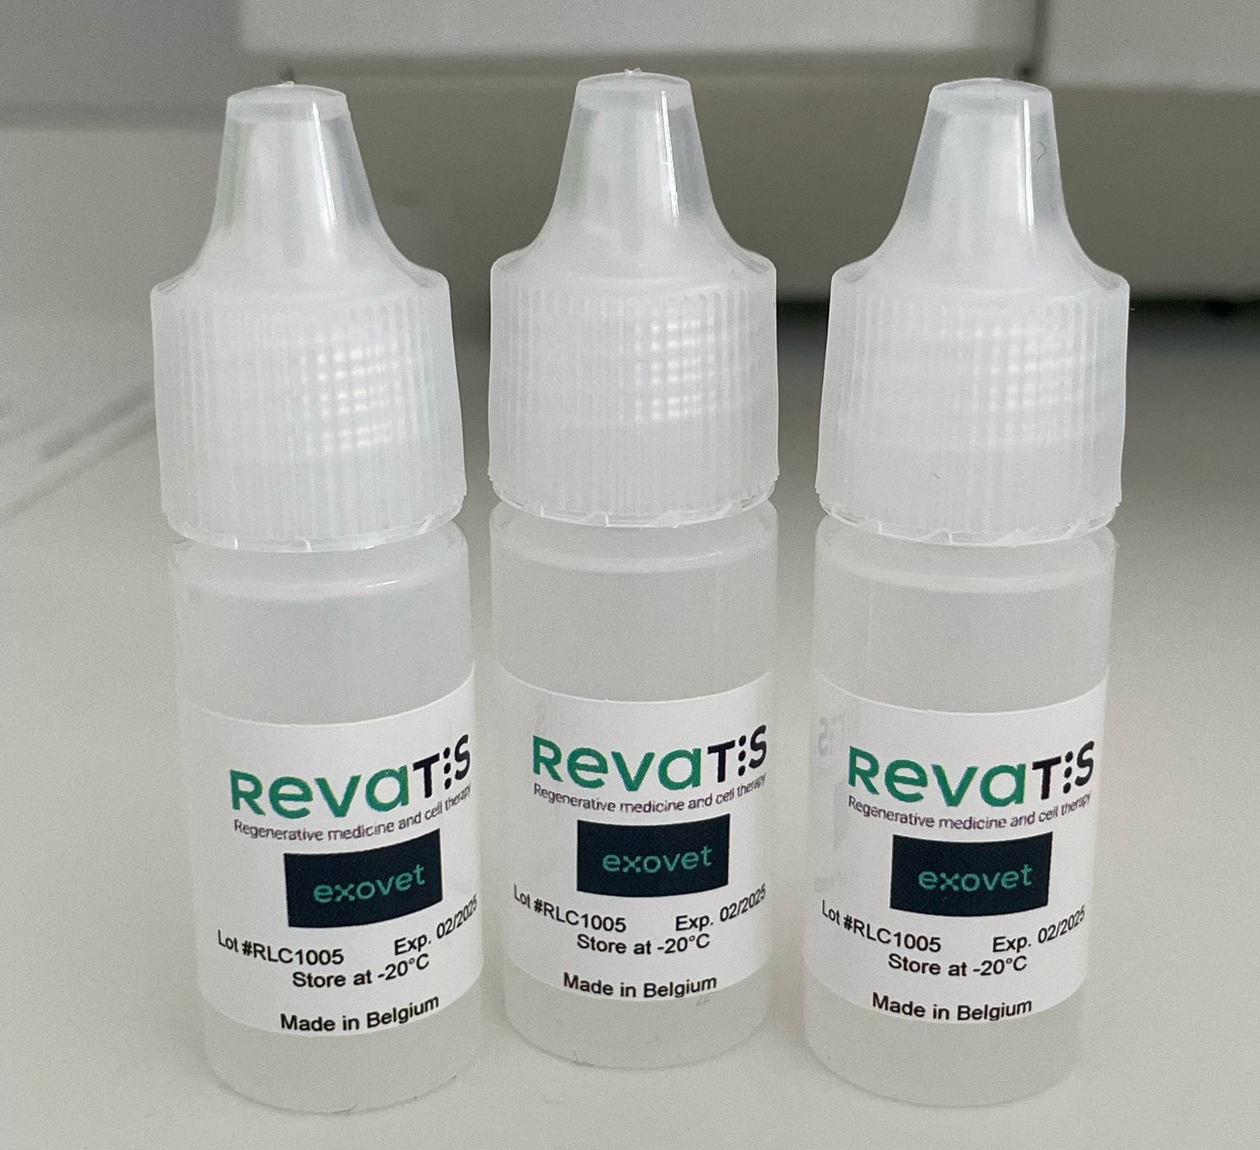
AXOVET: Veterinary therapeutic applications
Creation of Axovet (December 2024):
Subsidiary for the distribution of stem cell- or exosome-based products in Vet Med.
CELLIVET: mdMSCs
Autologous mdMSCs for Tendinopathy and Joint disease
Allogenic compatible mdMSCs for ophtalmologic conditions and for acute inflammation (Laminitis)
EXOVET: RLC100
RLC100 (EVs Biologics) for ophtalmologic conditions

Slide 3
AXOVET: Veterinary therapeutic and Diagnostic
.
Therapy
Locomotor system
Ophtalmology
Wound Heaing
Equine and companion animals
Diagnostic
Equine and companion animals
Innovative Vet medicinal products
Cell & Gene therapy
Immuno-therapy
Oncology
Looking for partners
With innovative technologies

Slide 4
Cellivet® Concept: muscle derived Stem Cells
Product | Type | Scientific basis | Stage | Core message
Cellivet One | Autologous mdMSCs | Directly derived from the patient’s own muscle tissue | ✅ Clinical validation completed | Personalized regenerative therapy
Cellivet Ready | Compatible allogeneic mdMSCs | Donor-based, GMP-produced compatible cells | 🟢 Clinical phase ongoing | Off-the-shelf rapid-response therapy
Cellivet Prime | Stimulated / optimized mdMSCs | mdMSCs activated ex-vivo by controlled stimuli (mechanical, biochemical, or photonic) to enhance potency and secretome output | 🔵 Pre-development concept | Next-generation stimulated cells — enhanced efficacy, faster recovery
Notes:
“Our Cellivet® Concept is evolving step-by-step.
Today, we provide Cellivet One, the personalized autologous therapy, and Cellivet Ready, the compatible off-the-shelf version used in severe or emergency cases.
The next phase, Cellivet Prime, is under R&D at Revatis — stimulated mdMSCs with enhanced regenerative capacity.
It represents the future of equine and camel regenerative medicine: faster recovery, greater cellular efficacy, and reduced inflammatory response.

Slide 5
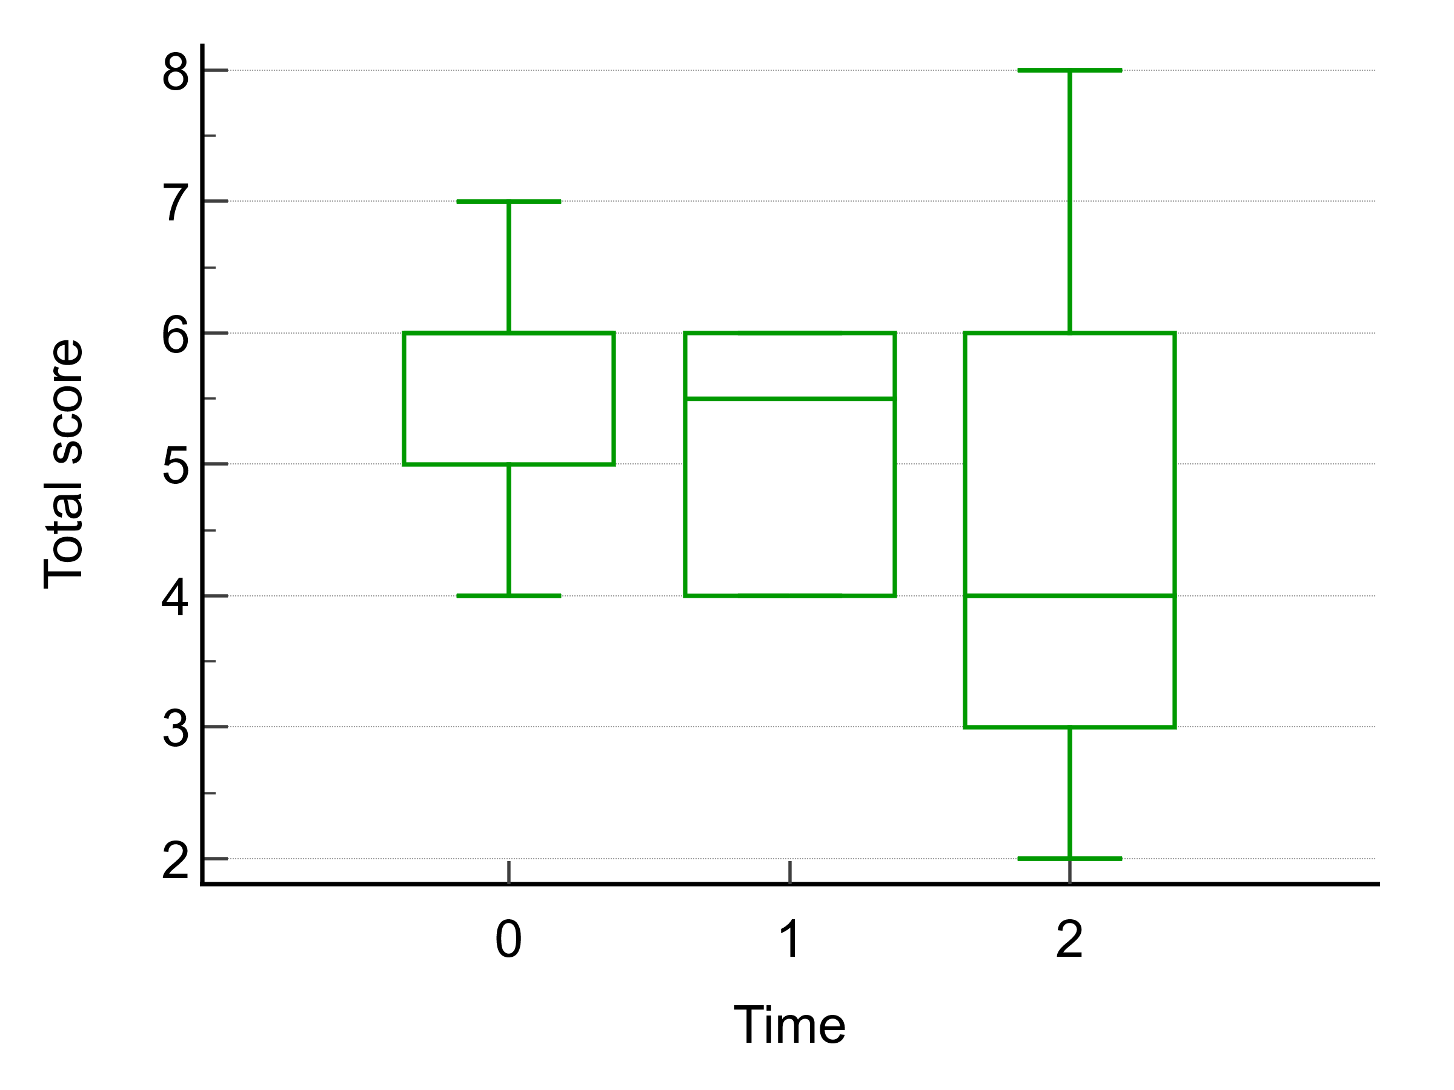
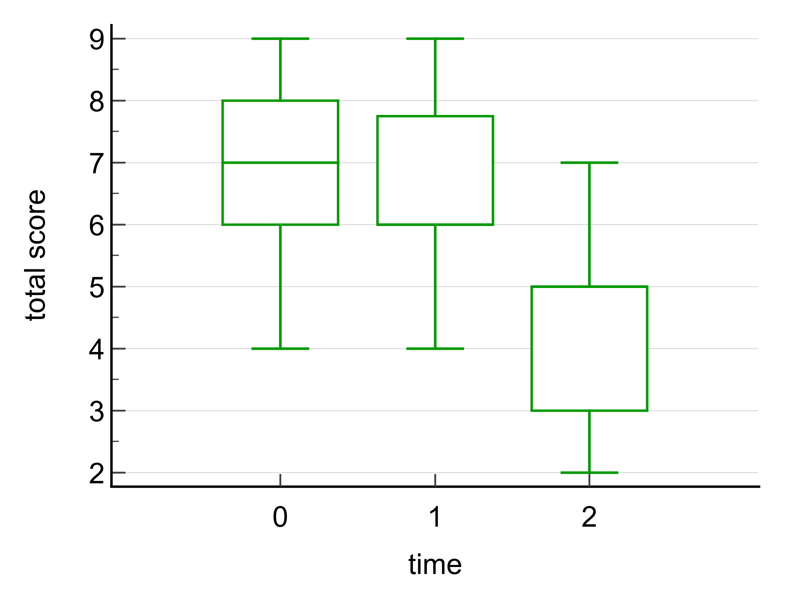
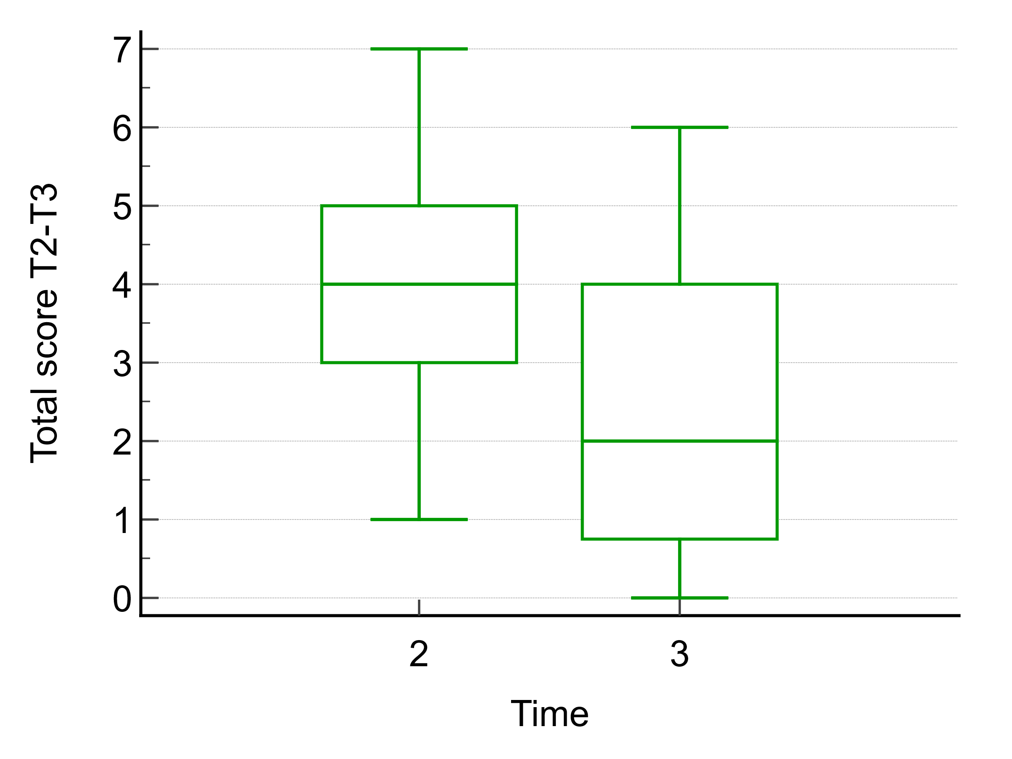
AXOVET: Veterinary therapeutic applications
Clinical study: CELLIVET One for Equine Tendinopathy
Efficacy and safety in autologous muscle-derived Stem Cells in horses affected by tendinopaty

Slide 6
EXOVET® Concept – Secretome & Extracellular Vesicle (EV) Biologics
Product | Technology | Main Indication | Current Status | Future Developments | Key Features
RLC100 Ophtha | Secretome / EVs (cell-free biologic) | Ophthalmology – immune keratitis, corneal ulcers, ocular surface regeneration | ✅ Preclinical and clinical validation completed (Equine) | Extension to camel ophthalmology (UAE 2026) | Non-immunogenic topical biologic; safe, stable, effective in equine model (n=30)
RLC100 Healing Gel | EV-enriched conditioned medium in topical gel form | Wound healing – chronic wounds, post-surgical repair, bone cysts | ✅ Clinical validation completed (Vet) | New topical formats for dermatology & equine limb wounds | Two-vial regenerative gel combining PRP and EVs for enhanced healing
RLC100 Inj. | Injectable EV biologic | Locomotor system – tendinopathy, joint inflammation, laminitis | 🟡 Preclinical phase (2026) | Future injectable biologic for equine & camel applications | Anti-inflammatory, trophic and immunomodulatory activity
RLC Prime | Stimulated secretome – optimized EV production | Next-generation multi-system biologic (eye, skin, locomotor) | 🔵 Pre-development concept (2026–2028) | High-potency secretome derived from stimulated mdMSCs | Linked to Cellivet Prime stimulation concept; under R&D at Revatis
Notes:
EXOVET® is Axovet’s cell-free regenerative platform, based on Revatis’ patented process for the collection and stabilization of the mdMSC secretome and extracellular vesicles (EVs).
These biologics offer anti-inflammatory, pro-regenerative and antimicrobial effects, without using live cells.

Slide 7
AXOVET: Veterinary therapeutic applications
RLC: Equine mdMSCs conditioned medium with a high concentration of EVs
Preclinical studies in equine ophthalmology
Excellent results for Immune keratitis (n=30)

Slide 8

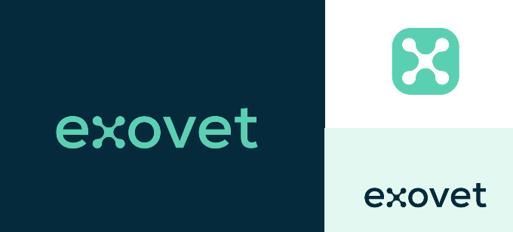
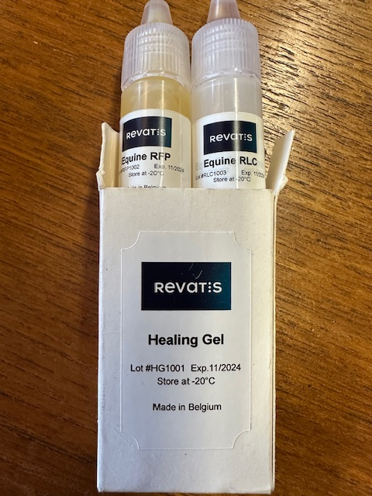
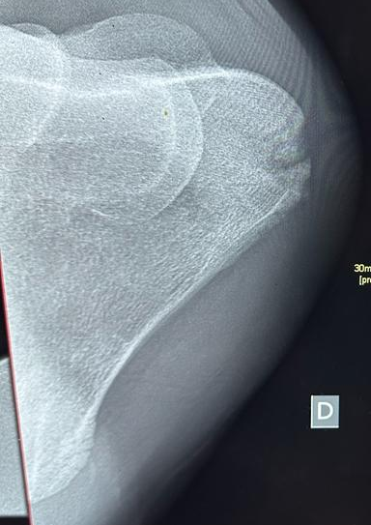
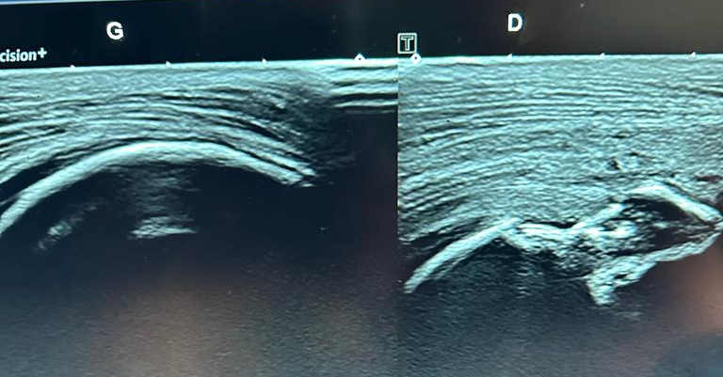
AXOVET: Veterinary therapeutic applications
VT
Healing Gel Kit Platelet-rich plasma combined with Exosomes
The Healing Gel kit consists of 2 vials.
One containing platelet-rich frozen plasma (RFP)
the other containing equine stem cell-derived extracellular vesicles (exosomes) (RLC).
→ The combination of these solutions produces a gel with regenerative and immunomodulatory and antiinfectious effects

Slide 9
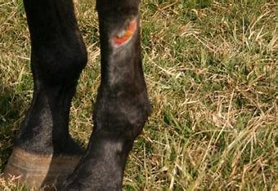
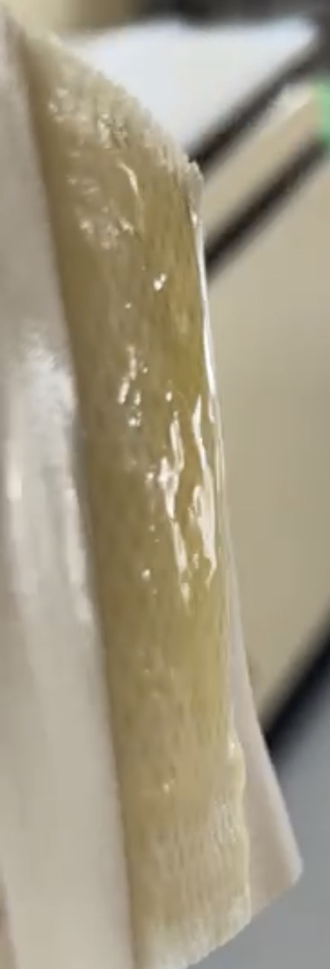
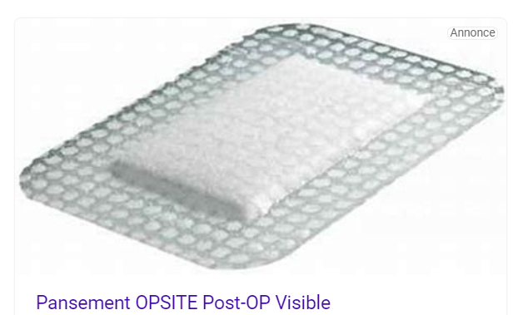

AXOVET: Veterinary therapeutic applications
Wound Healing

Slide 10
PRP SOLUTIONS – Autologous Plasma-Based Regenerative Kits
Product | Type | Main Indication | Status | Key Features
Axovet - PRP/T | Autologous PRP Kit | Tendon & ligament injuries | ✅ Marketed | Fast preparation • High platelet yield • Promotes tendon healing
Axovet – PRP/J | PRP + Hyaluronic Acid Kit | Joint disorders, osteoarthritis | ✅ Marketed | Combined PRP & HA • Improves joint lubrication & repair
Axovet-RFP | Allogenic Platelet lysate | Wound, eye, IA or IT | ✅Marketed | Blood products
Axovet – PRP/Evs | EV-enriched PRP (autologous secretome) | Joints & tendons (enhanced repair) | 🟡 In development (2025) | EV & cytokine-rich plasma • Cell-free • Higher regenerative power
Notes:
Axovet provides a complete range of PRP-based veterinary kits for musculoskeletal regeneration — from standard platelet concentrates to the next generation EV-enriched Secretome-PRP

Slide 11
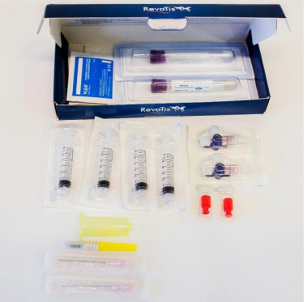
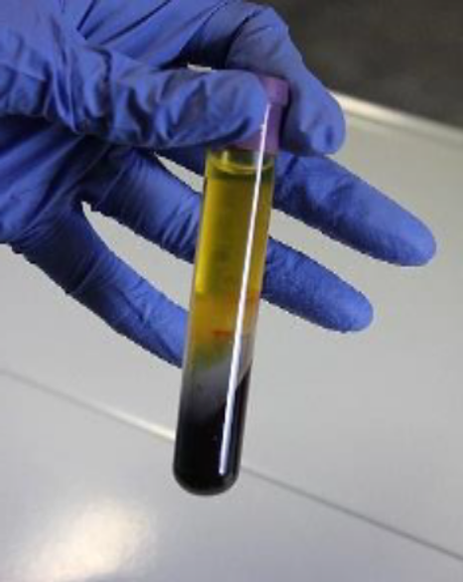
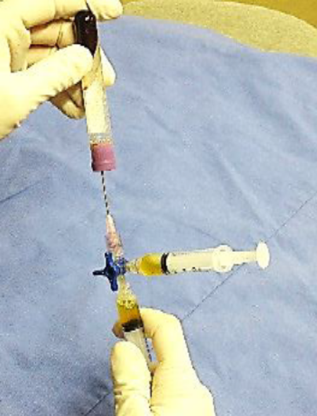
AXOVET: Veterinary therapeutic applications
VT
PRP Autologous kit
Specific tubes allowing the elimination of neutrophils and erythrocytes during the centrifugation process
Blood-derived mononucleated cells and blood-derived stem cells remain available for re-injection
Platelets’ concentration 4 to 6 times higher than blood concentration + High concentration of growth factors (TGFβ, PDGF, IL1 ra)
Low concentration of pro-inflammatory cytokines (TNFα, IL1 β, IL6) and oxidative and proteolytic enzymes (no neutrophil activation)
High alpha2 macroglobuline concentration
Entirely aseptic procedure
Possibility to add regenerative cells or hyaluronic acid

Slide 12
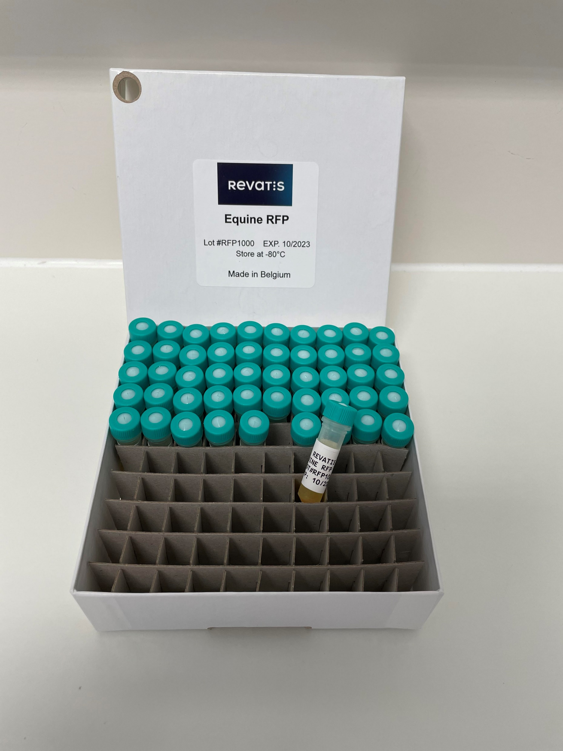
AXOVET: Veterinary therapeutic applications
VT
Plasmapherese (allogenic products)
Non Modified Blood Products
Fresh Frozen Plasma (Immunodeficiency and SIRS)
Rich frozen Platelets (RFP)
  - Platelet lysates 10⁹ /ml with leucoreduction
Garbin LC, Contino EK, Olver CS, Frisbie DD. A safety evaluation of allogeneic freeze-dried platelet-rich plasma or conditioned serum compared to autologous frozen products equivalents in equine healthy joints. BMC Vet Res. 2022 Apr 18;18(1):141. doi: 10.1186/s12917-022-03225-4. PMID: 35436878; PMCID: PMC9014566.
Camargo Garbin L, McIlwraith CW, Frisbie DD. Evaluation of allogeneic freeze-dried platelet lysate in cartilage exposed to interleukin 1-β in vitro. BMC Vet Res. 2019 Nov 1;15(1):386. doi: 10.1186/s12917-019-2118-z. PMID: 31675958; PMCID: PMC6824121.

Slide 13
INNOVATIVE DISTRIBUTED PRODUCTS – STRATEGIC PARTNERSHIPS
Product | Partner | Application | Scientific Basis | Clinical Status | Key Features
GlassBone (Putty or granules) | Noraker | Orthopedics & dentistry – bone defects | Bioactive composite (glass-ceramic + polymer matrix) | ✅ CE-marked – Human Medical device | Resorbable scaffold • Osteoconductive • Next-generation synthetic bone substitute
QuickSet (Putty) | Noraker | Orthopedic | Calcium-Phosphate Cement | ✅ CE-marked – Human Medical device
Happy Cross |  | Orthopedics | Hyaluronic Acid and Mannitol | ✅Human Medical Device | • Visco-supplement and antioxydant properties. • Next generation of Joint lubrification
NDS27 (Soluble Curcumin) | Mont-le-Soie Equine Research Group | Respiratory disorders in performance horses – Equine Asthma & Exercise-Induced Pulmonary Hemorrhage (EIPH) | Soluble curcumin derivative with anti-inflammatory & antioxidant properties | ✅ Clinical study completed in UAE on racing “bleeder” horses | Inhaled formulation • Reduces airway inflammation & bleeding • Safe & non-steroidal alternative

